Slide 1
Composite、Flyweight、Chain of Responsibility
2019/10/30 OOSE課輔

Slide 2
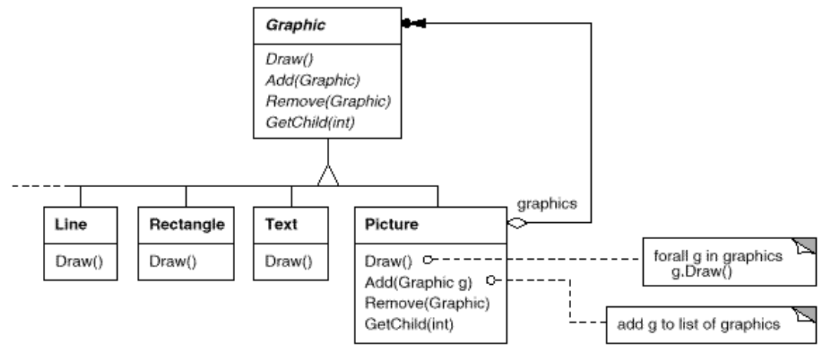
Composite
Intent
Compose objects into tree structures to represent part-whole hierarchies. Composite lets clients treat individual objects and compositions of objects uniformly.
Notes:
Intent：將物件組建成樹狀結構、作出部分-整體的層級關係，使外界可以已一致的方式去對待各個物件。

Slide 3
Composite
T
R
L
T
R
L
Suppose：
Composite
<- Picture
T
Leaf
T
<- Text
R
L
T
Leaf
R
<- Rectangle
R
L
Leaf
L
<- Line

Slide 4
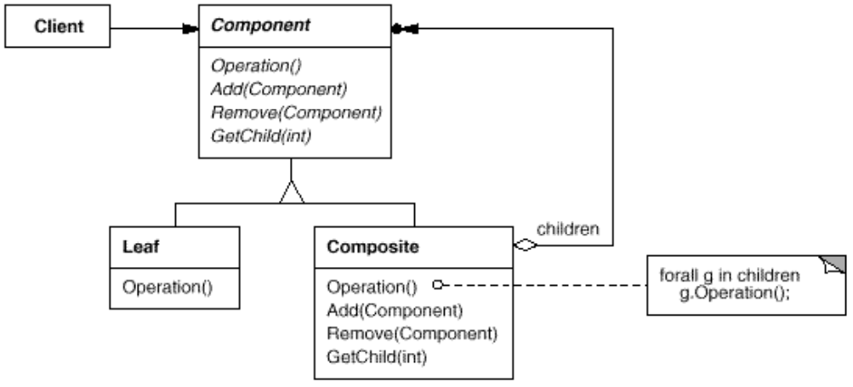
Structure
Composite
．．．
．．．
Leaf

Slide 5
Example
菜單
早餐
吐司
蛋吐司
巧克力吐司
蛋餅
起司蛋餅
鮪魚蛋餅
午餐
...
晚餐
…
甜點&飲料
…
菜單
早餐
午餐
晚餐
甜點&飲料
吐司
蛋餅
．．．
．．．
．．．
蛋吐司
起司蛋餅
巧克力吐司
鮪魚蛋餅

Slide 6
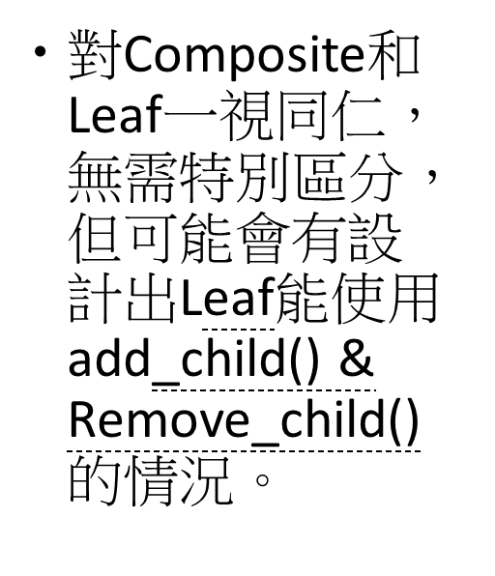
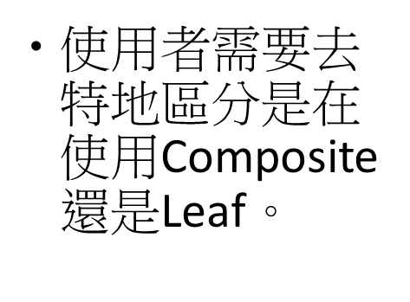
Safety & Transparency
Transparency
Safety
+printStruct()
+add_child()
+Remove_child()
Component
+printStruct()
Component
+printStruct()
+add_child()
+Remove_child()
Leaf
+printStruct()
+add_child()
+Remove_child()
Composite
+printStruct()
Leaf
+printStruct()
+add_child()
+Remove_child()
Composite

Slide 7
Code of Example

Slide 8
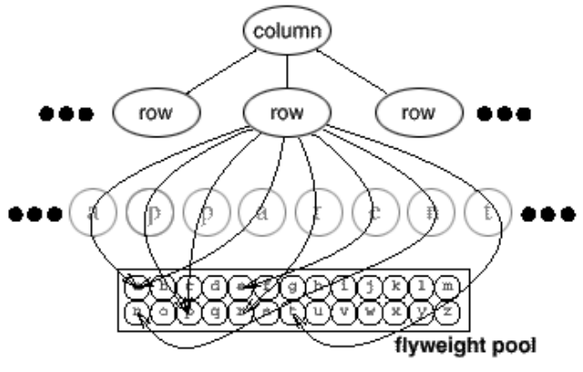
Flyweight
Intent
Use sharing to support large numbers of fine-grained objects efficiently.
Notes:
Intent：將物件組建成樹狀結構、作出部分-整體的層級關係，使外界可以已一致的方式去對待各個物件。

Slide 9
Flyweight
The class structure for these objects is shown next. Glyph is the abstract class for graphical objects, some of which may be flyweights. Operations that may depend on extrinsic state have it passed to them as a parameter. For example, Draw and Intersects must know which context the glyph is in before they can do their job.
Suppose：
a
b
c
d
e
f
.
.
.
x
y
z

Slide 10
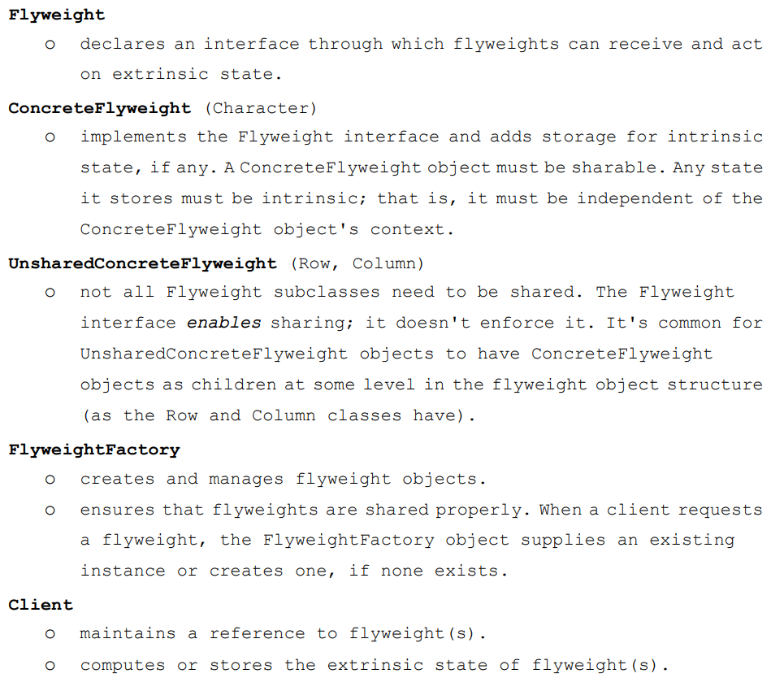
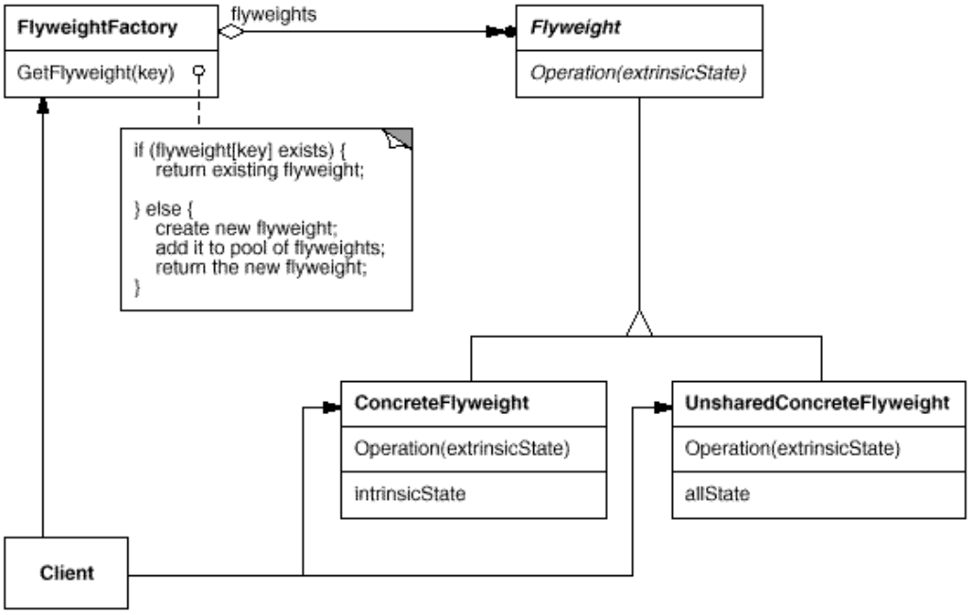
Structure

Slide 11
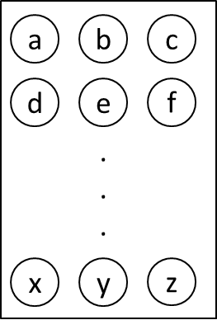
Example
Intrinsic：letter
Extrinsic：position
e

Slide 12
Code of Example

Slide 13
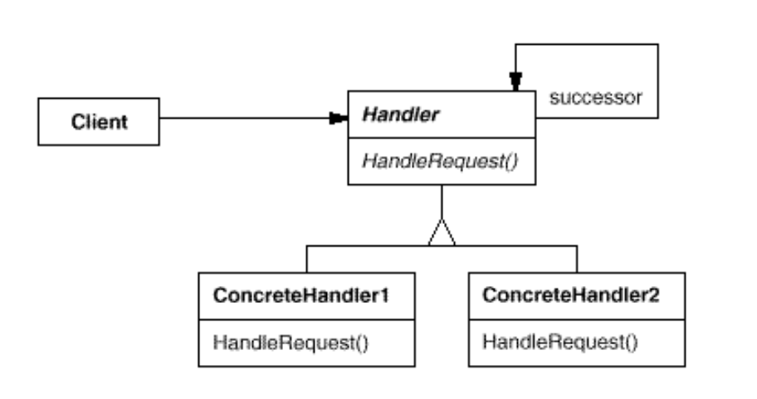
Chain of Responsibility
Intent
Avoid coupling the sender of a request to its receiver by giving more than one object a chance to handle the request. Chain the receiving objects and pass the request along the chain until an object handles it.

Slide 14
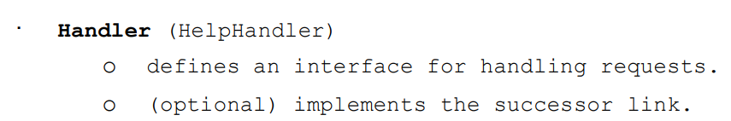
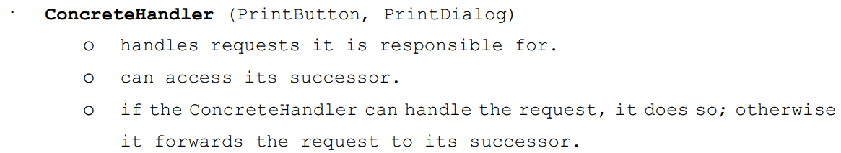
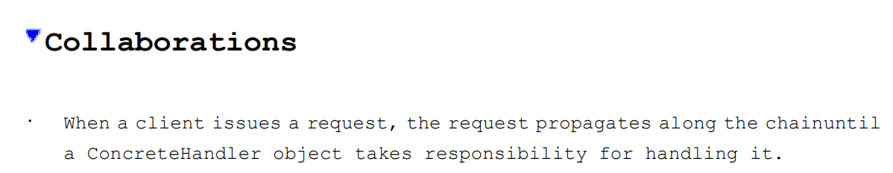
Structure

Slide 15
Example
Vending Machine
Personal Leave
Who has the greatest power to deal with the problem?
1
5
10
50
Instructor
Chairperson
Dean
President
Who has the greatest power to deal with the problem?
Is it appropriate that the president makes this approval?
Does this pattern need default if it cannot handle the question?
Is this pattern based on the priority? What is the rule of this pattern?

Slide 16
Code of Example

